Slide 1
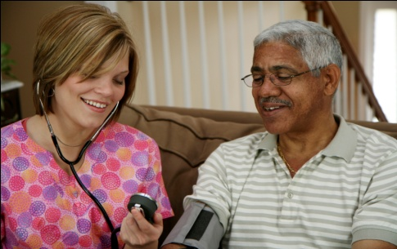
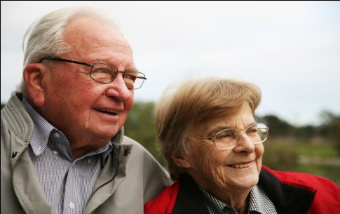
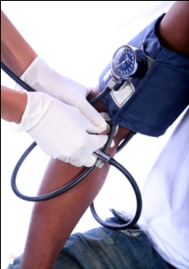

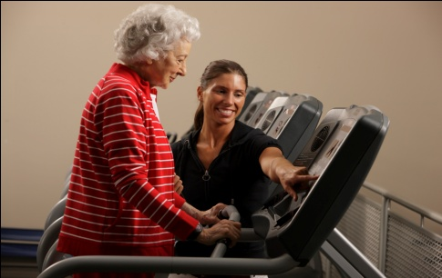


VTE
Venous Thromboembolism
Toolkit for Health Professionals
WHAT YOU NEED TO KNOW ABOUT BLOOD CLOTS

Slide 2
Chapter One
Venous Disease Coalition
Venous Thromboembolism
Toolkit for Health Professionals
VTE Toolkit

Slide 3
Venous Disease Coalition
The Venous Disease Coalition (VDC) is a collaborative alliance of over 35 leading health professional organizations and patient advocacy groups committed to improving the survival rates and quality of life for individuals with, or at risk for, venous disease
The VDC provides peer-reviewed educational materials for the general public and health care professionals
www.vasculardisease.org/venousdiseasecoalition/
VTE Toolkit

Slide 4
VDC Goals
To develop a national, participatory, diverse coalition that is firmly committed to improving public health via venous disease awareness and education;
To create media awareness of venous thromboembolism as an urgent public health hazard;
To provide a public forum for VDC member organizations, the National Institutes of Health (NIH) and Centers for Disease Control (CDC) to make one another aware of their existing programs and future plans for venous disease education.
VTE Toolkit

Slide 5
VDC Member Organizations
American Academy of Physician Assistants
American Academy of Nurse Practitioners
American College of Cardiology
American College of Chest Physicians
American College of Phlebology
American Osteopathic Association
American Radiological Nurses Assoc.
American Society of Health-System Pharmacists
American Society of Hematology
American Society for Clinical Oncology
American Thrombosis Hemostasis Network
American Venous Forum
Anticoagulation Forum
APS Foundation of America
Canadian Chapter Society for Vascular Nursing
Canadian Society for Vascular Surgery
Canadian Cardiovascular Society
Case Management Society
Hemophilia & Thrombosis Research Society
Institute for Safe Medication Practices
National Alliance of Thrombosis and Thrombophilia
National Gerontological Nursing Association
North American Thrombosis Forum
Preventive Cardiovascular Nursing Association
Society for Cardiovascular Angiography and Interventions
Society for Clinical Vascular Surgery
Society of Critical Care Medicine
Society of Interventional Radiology
Society for Vascular Medicine and Biology
Society for Vascular Nursing
Society of Vascular Ultrasound
Spirit of Women
Thrombosis Interest Group of Canada
Vascular Disease Foundation
VTE Toolkit

Slide 6
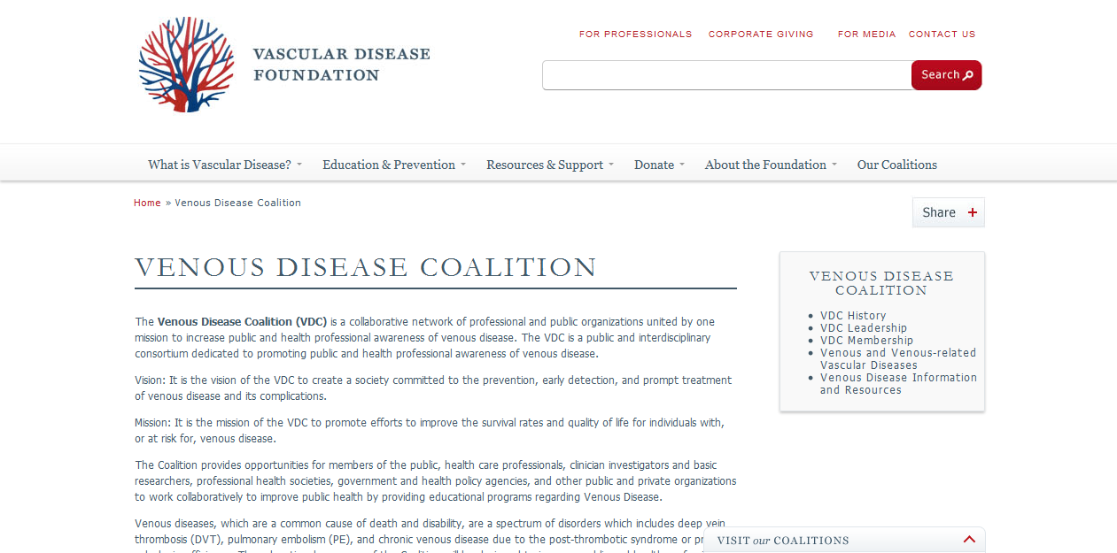
www.vasculardisease.org/venousdiseasecoalition/
VTE Toolkit

Slide 7
Venous Disease Coalition
www.vasculardisease.org/venousdiseasecoalition/
VTE Toolkit

