Slide 1
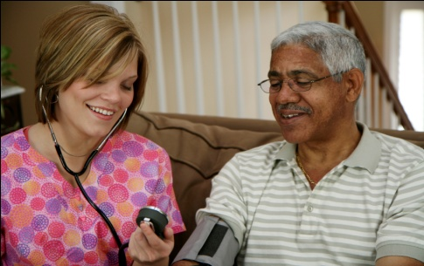

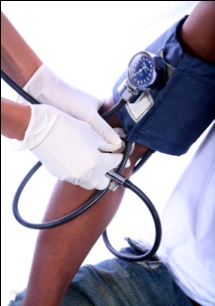




Chapter Ten
Venous Disease Coalition
Hypercoagulability
VTE Toolkit

Slide 2
Thrombophilia = Hypercoagulability
Factor V Leiden
Prothrombin 20210A variant
Antiphospholipid Ab syndrome
- lupus anticoagulant
- anticardiolipin antibody
Deficiencies of:
Antithrombin
Protein C
Protein S
Heparin cofactor II
↑ Factor VIII, IX, XI, II
Hyperhomocysteinemia
Fibrinolytic dysfunction
Myeloprolif. disorders:
- PRV, ET
Dysfibrinogenemia
DIC
DIC = disseminated intravscular coagulation;
ET = essential thrombocytosis; PRV = polycythemia rubra vera
VTE Toolkit

Slide 3
Which patients have an increased risk of having a hypercoagulable state?
      Unprovoked VTE at a young age
      Recurrent, unprovoked VTE events
      VTE with positive family history
      VTE at an unusual site
VTE Toolkit

Slide 4
Which patients have an increased risk of having a hypercoagulable state?
      Unprovoked VTE at a young age
      Recurrent, unprovoked VTE events
      VTE with positive family history
      VTE at an unusual site
  AND ALSO
    Any unprovoked VTE event
    VTE with minor risk factor such as BCP, HRT, pregnancy, travel, bedrest only
    Unexplained, recurrent pregnancy losses
VTE Toolkit

Slide 5
General Indications for
Hypercoagulability Testing
ONLY if patient management will be
affected by the result:
Management
affected?
  Duration of anticoagulation (rarely)
  Another medical intervention
      pregnancy prophylaxis (sometimes)
      BCP, HRT avoidance (possibly)
  Family counseling (virtually never)
VTE Toolkit

Slide 6
Principles of
Hypercoagulability Testing
    Should only by done by experts
    - both in hypercoagulability + in the provision
    of evidence-based patient counseling
    2. Only if management is (should be) affected by the result = rare
    Almost never test relatives
    - net harm generally greater than net benefit
VTE Toolkit

Slide 7
Venous Disease Coalition
www.vasculardisease.org/venousdiseasecoalition/
VTE Toolkit

