Slide 1
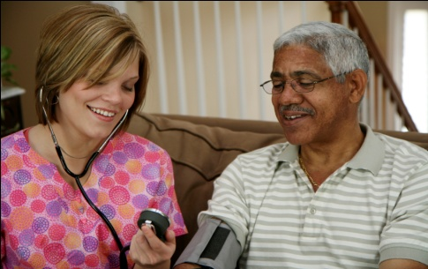
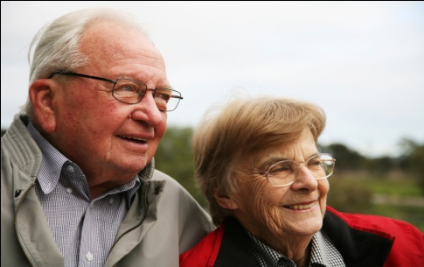
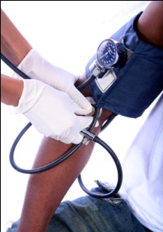
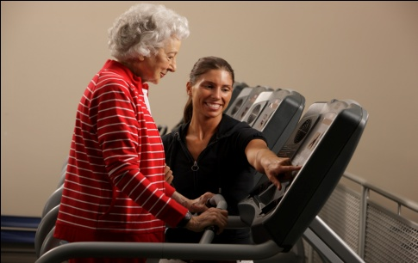
Chapter Twelve
Venous Disease Coalition
Prevention of VTE
VTE Toolkit

Slide 2
Symptomatic VTE after Surgery
California Patient Discharge Database (N = 1,653,275)
VTE during surgical admission or within 3 months
Thromboprophylaxis data was not available
Benign disease
Hip replacement 2.4%
Craniotomy 2.3%
Knee replacement 1.7%
Coronary bypass 1.1%
Colectomy 1.1%
Hysterectomy 0.3%
TUR prostate 0.3%
Lap. cholecystectomy 0.2%
Malignant disease
Craniotomy 3.6%
Colectomy 1.7%
Pneumonectomy 1.6%
Rad. Prostatectomy 1.5%
Hysterectomy 1.2%
Mastectomy 0.4%
White - Thromb Haemost 2003;90:446
VTE Toolkit

Slide 3
Postoperative VTE is Associated with Increased Mortality
118,258 surgical patients in 120 VA hospitals
VTE | 30-day mortality
No | 4.4% | p<0.0001
Yes | 16.9%
Symptomatic VTE is associated with significantly increased 30-day mortality
Gangireddy - J Vasc Surg 2007;45:335
VTE Toolkit

Slide 4
VTE is a Common Complication After Surgery (review of 7.5 million discharges from 994 US hospitals)
Postoperative DVT or PE:
2nd most common medical complication overall
2nd most common cause of excess length of stay
3rd most common cause of excess mortality
3rd most common cause of excess charges
Zhan - JAMA 2003;290:1868
VTE Toolkit

Slide 5
Thromboprophylaxis Reduced Mortality after Hip Fracture 50 Years Ago!!
(randomized trial)
Controls Phenindione*
n=150 n=150
Symptomatic DVT 29 % >> 3 %#
Symptomatic PE 5 % >> 0
Total deaths 28 % >> 17 %
Autopsy - DVT 83 % >> 14 %
- major PE 41 % >> 10 %
* from admission to ambulation (~5 weeks); PT 25-40 sec
# all after phenindione stopped
Sevitt & Gallagher – Lancet 1959:2:981
VTE Toolkit

Slide 6
Low Dose Heparin Reduced DVT in 46 RCTs of Surgical Patients (n=15,598)
25
20
15
10
5
0
22 %
Control
Risk
Reduction
59 %
Low dose heparin
%
9 %
DVT
Collins – NEJM 1988;318:1162
VTE Toolkit

Slide 7
Reduction in DVT Correlated with Reduction in Fatal PE in 46 RCTs of 16,000 Surgical Patients
25
20
15
10
5
0
22 %
Risk
Reduction
59 %
Control
Low dose heparin
%
Risk
Reduction
63%
9 %
0.8 %
0.3 %
DVT Fatal PE
Collins – NEJM 1988;318:1162
VTE Toolkit

Slide 8
Prevention of Venous Thromboembolism
1986
1989
1992
1995
1998
2001
2004
Chest – June 2008
VTE Toolkit

Slide 9
Thromboembolism Risk Groups
8th ACCP Guidelines on the Prevention of VTE
General surgery
Vascular surgery
Gynecologic surgery
Urologic surgery
Thoracic surgery
Bariatric surgery
Laparoscopic surgery
Coronary bypass surgery
Hip arthroplasty
Knee arthroplasty
Knee arthroscopy
Hip fracture surgery
Spine surgery
Lower extremity injuries
Neurosurgery
Major trauma
Spinal cord injuries
Burn patients
Medical patients
Cancer patients
Central venous catheters
Critical care patients
Long distance travel
Geerts – Chest 2008;133:381S
VTE Toolkit

Slide 10
8th ACCP Guidelines on Antithrombotic Therapy
1.2 VTE Prophylaxis Policy
1.2.1 We recommend that every general hospital develop a formal, active strategy that addresses the prevention of VTE [Grade 1A]
Geerts – Chest 2008;133:381S
VTE Toolkit

Slide 11
How Can VTE be Prevented in Hospitals?
Getting patients up and walking as early as possible helps . . .
but this is not enough
Giving patients low doses of an anticoagulant every day
VTE Toolkit

Slide 12
The Myth of Mobility and DVT
Immobility ALONE rarely results in DVT
Immobility does increase the risk of symptomatic VTE after another risk factor (surgery, trauma, acute medical illness, cancer, etc.)
After another thrombosis insult, mobilization does NOT eliminate or substantially reduce the VTE risk for some time
∴The duration of prophylaxis should not be determined by mobility status alone
VTE Toolkit

Slide 13
Mechanical Methods of Prophylaxis
Graduated compression stockings (medical grade stockings, ?TEDSTM
Intermittent pneumatic compression devices (SCDs^{TM,}, leg squeezers)
Foot pumps
If used properly, these methods work in some patient groups, but
They generally don’t work as well as anticoagulants,
and
They require a big effort to work at all
VTE Toolkit

Slide 14
Mechanical Methods of Prophylaxis
Who should receive mechanical prophylaxis?
Patients at high risk for bleeding
? Along with an anticoagulant method to try to improve protection
VTE Toolkit

Slide 15
Mechanical Methods of Prophylaxis
Ensure they fit properly
Start ASAP
Have on ~24 hours/day – only remove for leg washing and when patient is actually walking
Ensure optimal compliance
Only stop at discharge
VTE Toolkit

Slide 16
Pharmacologic (anticoagulant) Methods of Prophylaxis
Low dose heparin / minidose heparin
heparin 5,000 U SC Q12H or Q8H
Low molecular weight heparin
enoxaparin (Lovenox) 40 mg SC QD or 30 mg SC Q12H
dalteparin (Fragmin) 5,000 U SC QD
tinzaparin (Innohep) 3,500 or 4,500 U SC QD
Fondaparinux (Arixtra) 2.5 mg SC QD
Warfarin (Coumadin)
Oral Factor Xa inhibitors, IIa inhibitors
rivaroxaban (Xarelto), dabigatran (Pradax)*
*not approved in USA
VTE Toolkit

Slide 17
Pharmacologic (anticoagulant) Methods of Prophylaxis
Using Anticoagulant Prophylaxis:
Start as soon as safe - once bleeding stopped
- usually day after admission or surgery
Try to avoid missing any doses
- don’t hold for most procedures
- consider routine qhs dosing
3. Continue at least until discharge
VTE Toolkit

Slide 18
DVT Prophylaxis: 3 Patient Groups
Low risk
NO prophylaxis
Moderate risk
ROUTINE prophylaxis
High risk
8th ACCP Conference on Antithrombotic Therapy - Chest 2008
VTE Toolkit

Slide 19
Thromboprophylaxis in Moderate Risk Medical or Surgical Patients
Patients Medical: bedrest, sick
Surgical: general, gynecologic, urologic,
thoracic, bariatric, neurosurgery
Options - Low molecular weight heparin
- Low dose heparin
- Fondaparinux
- Mechanical if high bleeding risk
Duration Until discharge
8th ACCP Conference on Antithrombotic Therapy - Chest 2008
VTE Toolkit

Slide 20
Thromboprophylaxis in High Risk Patients
Patients Major orthopedic:
(hip and knee arthroplastyhip fracture repair)
Major trauma
Options - Low molecular weight heparin
- Fondaparinux
- Warfarin (INR 2-3)
- Mechanical if high bleeding risk
Duration At least 10 days (2-5 weeks)
8th ACCP Conference on Antithrombotic Therapy - Chest 2008
VTE Toolkit

Slide 21
LDH vs LMWH
Factor LDH LMWH
Efficacy ++ to +++ +++
Safety +++ +++
Dosing 2-3 x/day once daily
Accum. in renal insuff. No ? - no
HIT potential low very low
dost + + to ++
Indicated for all pts no yes
VTE Toolkit

Slide 22
Thromboprophylaxis in Major Orthopaedic Surgery
THR TKR HFS
Routine
Prophylaxis yes yes yes
LMWH [1A] LMWH [1A] fonda [1A]
Recommended fonda [1A] fonda [1A] LMWH [1B] warfarin [1A] warfarin [1A] warfarin [1B]
?IPC [1B] LDUH [1B]
ASA [1A] ASA [1A] ASA [1A]
Not LDUH [1A] LDUH [1A]
Recommended GCS [1A] VFP [1B]
VFP [1A]
Geerts – Chest 2008;133:381S
VTE Toolkit

Slide 23
LMWH vs Warfarin in Arthroplasty
Warfarin LMWH
Onset of action delayed 3-5 days rapid 1-3 hours
Anticoag. effect unpredictable predictable
Lab monitoring yes no
Efficacy ++ +++
Effectiveness +++* +++
Early bleeding +/- +/-
Late bleeding + +/-
Drug cost +/- ++
Total cost ++ ++
Complexity yes no
*assumes optimal use
VTE Toolkit

Slide 24
Some Patients Need Post-Discharge Thromboprophylaxis (Readmissions to Hospital for VTE)
THR
~3 months
TKR
~1 month
Discharge
N=43,645
White - Arch Intern Med (1998)
VTE Toolkit

Slide 25
Extended Prophylaxis Reduces Both Asymptomatic DVT and Symptomatic VTE after Arthroplasty
25
20
15
10
5
0
21%
In-hospital prophylaxis
Risk
Reduction
61%
Extended prophylaxis
%
Risk
Reduction
62%
8.2%
4.5%
1.7%
Venographic DVT Symptomatic VTE
(meta-analysis of 9 RCTs, 3,999 patients)
Eikelboom – Lancet 2001;358:9
VTE Toolkit

Slide 26
Extended Prophylaxis Reduces Both Asymptomatic DVT and Symptomatic VTE in Hip Surgery
33%
35
30
25
20
15
10
5
0
Placebo
Risk
Reduction
96%
Fondaparinux
%
Risk
Reduction
89%
1.4%
2.7%
0.3%
Venographic DVT Symptomatic VTE
Eriksson – Arch Intern Med 2003;163:1337
VTE Toolkit

Slide 27
Duration of Thromboprophylaxis in Major Orthopaedic Surgery
THR TKR HFS
At least 20 days yes [1A] yes [1A] yes [1A]
Beyond 10 days yes [1A] yes [1A] yes [1A]
- up to 35 days
Options LMWH [1A] LMWH [1C] fonda [1A]
OVKA [1A] OVKA [1C] LMWH [1C]
fonda [1C] fonda [1C] OVKA [1C]
8th ACCP Conference on Antithrombotic Therapy - Chest 2008
VTE Toolkit

Slide 28
Which Hospital Patients Should Receive Thromboprophylaxis?
Sick medical patients
General surgical
Major gynecologic
Major urology
Neurosurgery
Orthopedics
Trauma
ICU
i.e. most patients in hospital
VTE Toolkit

Slide 29
Simplifying DVT Prophylaxis: 2 Patient Groups
Low risk
= no prophylaxis
At risk
= routine evidence-based prophylaxis
VTE Toolkit

Slide 30
Which Thromboprophylaxis Options Do We Have to Choose From?
Anticoagulant Options:
LDH – BID or TID
LMWH – dalteparin, enoxaparin, tinzaparin
Fondaparinux
Rivaroxaban
Choose 1 (or possibly 2):
________________
________________
Mechanical Options:
GC stockings
Seq compr. devices
Choose 1:
________________
i.e. only 2 or 3 options
VTE Toolkit

Slide 31
ACCP Thromboprophylaxis Recommendations
 | LDH | LMWH | Fonda | Warfarin
General surgery | 1A | 1A | 1A | no
Gynecologic surgery | 1A | 1A | 1C | no
Urologic surgery | 1B | 1C | 1C | no
Coronary art bypass surgery | 1C | 1C | no | no
Hip replacement | no | 1A | 1A | 1A
Knee replacement | no | 1A | 1A | 1A
Hip fracture surgery | 1B | 1B | 1A | 1B
Neurosurgery | 2B | 2A | no | no
Major trauma | no | 1A | no | no
Medical patients | 1A | 1A | 1A | no
Critical care patients | 1A | 1A | no | no
Geerts – Chest 2008;133:381S
VTE Toolkit

Slide 32
Default (“opt-out”) Prophylaxis
Everyone gets routine, evidence-based prophylaxis
Unless thrombosis risk too low
Everyone gets anticoagulant prophylaxis
Unless bleeding risk too high
Obsessive mechanical prophylaxis
VTE Toolkit

Slide 33
Thromboprophylaxis Approach
All admitted patients
Prophylaxis
Indicated?
no
Fully mobile
Brief length of stay
yes
Anticoagulant prophylaxis
contra-indicated?
yes
Active bleeding
Hi bleeding risk
no
LMWH (one
dose for ~all)
Mechanical
Reassess daily
VTE Toolkit

Slide 34
ANY and RECOMMENDED Thromboprophylaxis Use
100%
75%
50%
25%
0
N=123,304
Any prophylaxis
73%
Recommended prophylaxis
30%
26%
22%
22%
18%
9%
7%
52%
9%
15%
13%
10%
4%
7%
3%
Ortho Spinal Med Gen Urol Trauma Gyne Neuro surg . surg.
Yu – Am J Health-Syst Pharm 2007;64:69
VTE Toolkit

Slide 35
International Thromboprophylaxis Use
Surgical and medical patients admitted to 358 randomly selected, acute care hospitals in 32 countries on 6 continents
Cross-sectional chart audit on one particular day
Surgical Medical
(N=30,827) (N=37,356)
At risk for VTE* 64% 42%
Any prophylaxis given 64% 48%
Recommended
Prophylaxis*given 59% 40%
*using 2004 ACCP recommendations (type of prophylaxis only)
Cohen – Lancet 2008:371:387
VTE Toolkit

Slide 36
Thromboprophylaxis Used After THR/TKR: Geographic Variation
100 hospitals in 13 countries
Prophylaxis USA Others
on Day 1 (n=7,008) (n=6,007)
LMWH 42% 100%
Warfarin 58% <<1%
Australia
Brazil
Bulgaria
Canada
Columbia
Germany
Italy
Japan
Poland
Spain
Turkey
UK
Warwick - JBJS 2007;89-B:799
VTE Toolkit

Slide 37
Prophylaxis Use in Medical Patients
1,894 medical patients in 29 hospitals in Canada
100%
75%
50%
25%
0
90%
23%
15%
Prophylaxis Prophylaxis Recommended
indicated given prophylaxis
Khan – Thromb Res 2007;119:145
VTE Toolkit

Slide 38
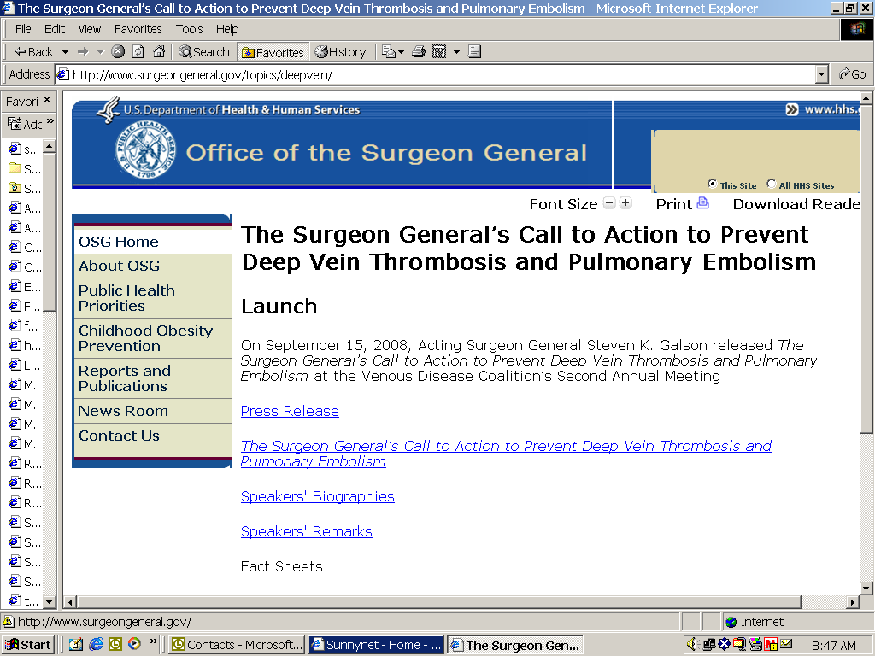
VTE Toolkit

Slide 39
Surgeon General’s Call to Action
Venous Thromboembolism (VTE)
Estimated that 350,000 to 600,000 Americans are afflicted by VTE each year
Also, estimated that at least 100,000 deaths each year are related to VTE
The Surgeon General’s Call to Action To Prevent DVT/PE 2008
VTE Toolkit

Slide 40
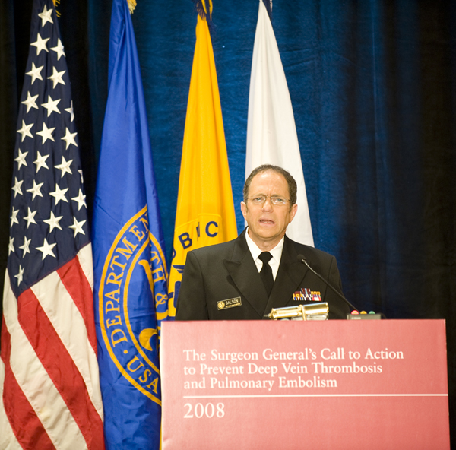
Surgeon General’s Call to Action
Dr. Galson laid out recommendations for the prevention of two common, yet deadly major public health threats: DVT and PE
The plan emphasized the need for:
Increased awareness about DVT/PE
Evidence-based practices for DVT
More research on the causes, prevention and treatment of DVT
VTE Toolkit

Slide 41
VTE Toolkit

Slide 42
Improving Thromboprophylaxis
What does NOT work?
Education
Grand rounds
Reminders
Hospital policy
Local champion
Producing order sets
VTE Toolkit

Slide 43
Improving Thromboprophylaxis
What DOES work?
Having a hospital thromboprophylaxis policy
PLUS KEEP IT SIMPLE
PLUS local champion/leader
PLUS education of docs, pharmacists, nurses
PLUS mandatory use of order sets
PLUS empower everyone to be involved – nursing, pharmacist (“It’s what we do here”)
PLUS audit and feedback
VTE Toolkit

Slide 44
Thromboemolism in Hospitals
We know who’s at risk for VTE
We know the consequences of unprevented VTE
We know how to prevent VTE with effective, safe, simple, and inexpensive interventions, So . . .
Just do it!
VTE Toolkit

Slide 45
Venous Disease Coalition
www.vasculardisease.org/venousdiseasecoalition/
VTE Toolkit

