Slide 1
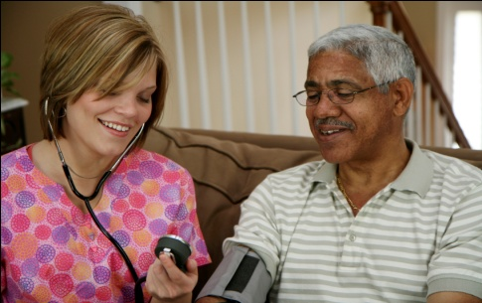
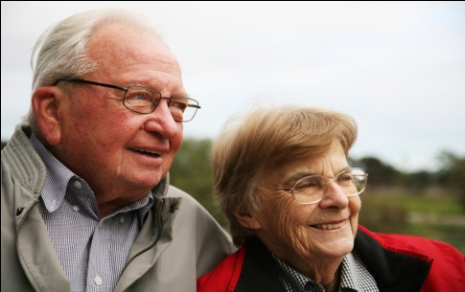
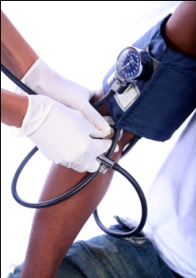

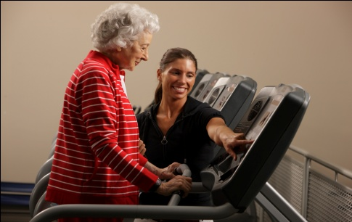


Chapter Two
Venous Disease Coalition
Pathogenesis and
Consequences of VTE
VTE Toolkit

Slide 2
Venous Thromboembolism (VTE)
=
1. Deep vein thrombosis (DVT)
2. Pulmonary embolism (PE)
VTE Toolkit

Slide 3
Definition
DVT
PE
VTE (venous thromboembolism)
VTE Toolkit

Slide 4
What Causes the
Blood to Clot When it Shouldn’t?
Activation of clotting system
Venous
stasis
Blood clot
Injury to the blood vessel wall
Virchow’s
Triad
VTE Toolkit

Slide 5
Virchow’s Triad
    Activation of clotting system (hypercoagulability)
    Venous stasis
    3) Endothelial injury/vessel wall injury
Dr. Rudolf Virchow 1856
VTE Toolkit

Slide 6
Virchow’s Triad
Activation of Coagulation (Hypercoagulability)
Congenital Hypercoagulability Disorders
      Factor V Leiden
      Prothrombin G20210A Polymorphism
      Protein C and/or Protein S deficiency
      Dysfibrinogenemia
      Antithrombin deficiency
VTE Toolkit

Slide 7
Virchow’s Triad
Activation of Coagulation (Hypercoagulability)
  Pregnancy:
    Risk of thrombosis during postpartum period is 5 times greater than during pregnancy
    It takes ~ 2 months after delivery for the coagulation and fibrinolytic systems to return to normal
Segal JA & Liem TK. Congenital and Acquired Hypercoagulable Syndromes. In Bergan JJ (ed.)
The Vein Book. Burlington, Elsevier 2007; 339-346.
VTE Toolkit

Slide 8
Virchow’s Triad
Activation of Coagulation (Hypercoagulability)
  Pregnancy:
    Increases in Factors I, VII, VIII, IX, X, XI
    Increased platelet count
    Decreased Protein S and Antithrombin
    Inhibition of fibrinolytic system by factors from placenta
    Increased venous stasis secondary to compression of pelvic veins by gravid uterus
Segal JA & Liem TK. Congenital and Acquired Hypercoagulable Syndromes. In Bergan JJ (ed.)
The Vein Book. Burlington, Elsevier 2007; 339-346.
VTE Toolkit

Slide 9
Virchow’s Triad
Activation of Coagulation (Hypercoagulability)
  Malignancy:
    VTE is a major complication in cancer patients
    1 in 5 cancer patients experience a thrombotic event
    Cancer patients are at 7 times greater risk than general population for VTE - greatest risk with hematologic cancers followed by lung and GI tract cancers
Khorana – J Clin Oncol 2009;27:4839
VTE Toolkit

Slide 10
Virchow’s Triad
Activation of Coagulation (Hypercoagulability)
  Malignancy:
    Risk for VTE in cancer is greater if patient also has distant metastases, Factor V Leiden or Prothrombin 20210A mutation
    Chemotherapy increases the risk for VTE by multiple mechanisms: direct toxicity to vascular endothelium, release of procoagulants from activated cancer cells, suppression of natural anticoagulants and fibrinolytics
Khorana – J Clin Oncol 2009;27:4839
VTE Toolkit

Slide 11
Virchow’s Triad
Venous Stasis
    Varicose Veins:
      Thrombosis occurs commonly in the varicose veins and can migrate to deep venous system
VTE Toolkit

Slide 12
Virchow’s Triad
Venous Stasis
  Travel and VTE:
    Long Haul Travel – “economy class syndrome”
    Velocity of venous blood decreases by 2/3 in the seated position
Ferrari - Travel as a risk factor for venous thromboembolic disease:
A case-control study. Chest 1999;115:440
VTE Toolkit

Slide 13
Virchow’s Triad
Endothelial Injury
  Partial rupture of calf muscles and knee ligament injury were more strongly associated with VTE than were contusions or simple sprains
  Risk of VTE was increased 50 fold in those who had injury and Factor V Leiden mutation
  Risk of VTE was increased 9 fold in those who had injury and Prothrombin 20210A mutation
Van Stralen - Arch Intern Med 2008;168:21
VTE Toolkit

Slide 14
V T E R i s k F a c t o r s
Small DVT
~10%
Big DVT
~50%
PE
<5%
Death
VTE Toolkit

Slide 15
V T E R i s k F a c t o r s
90%
Small DVT
resolve
~10%
30-50%
post-thrombotic syndrome
Big DVT
~50%
thromboembolic pulmonary hypertension
PE
<5%
<5%
Death
VTE Toolkit

Slide 16
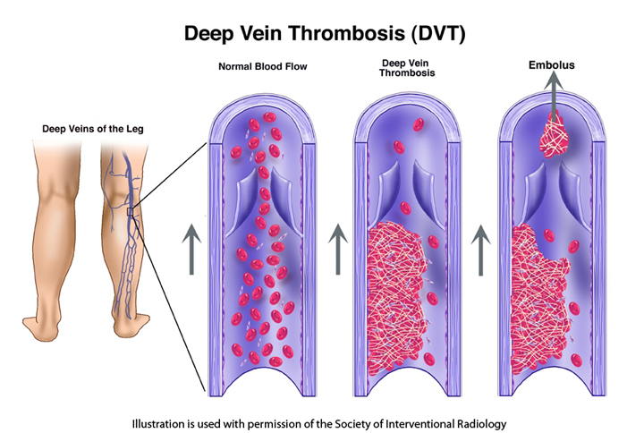
VTE Toolkit

Slide 17
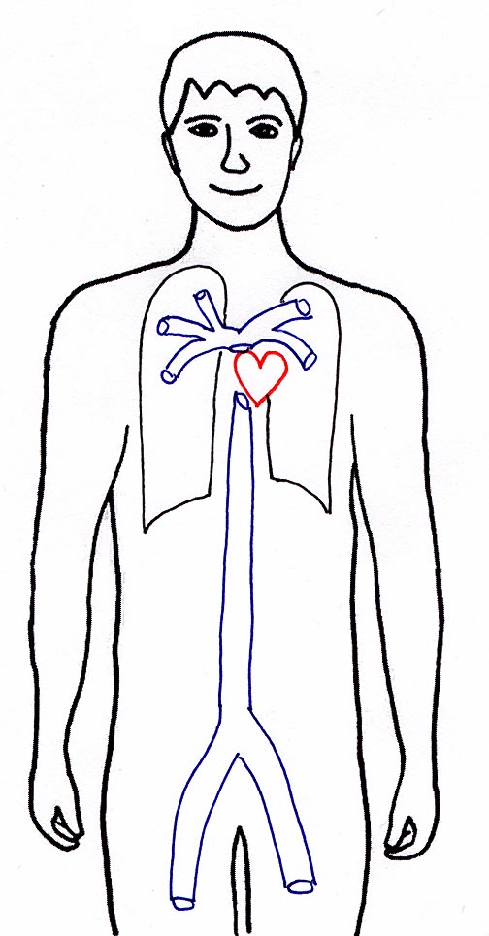
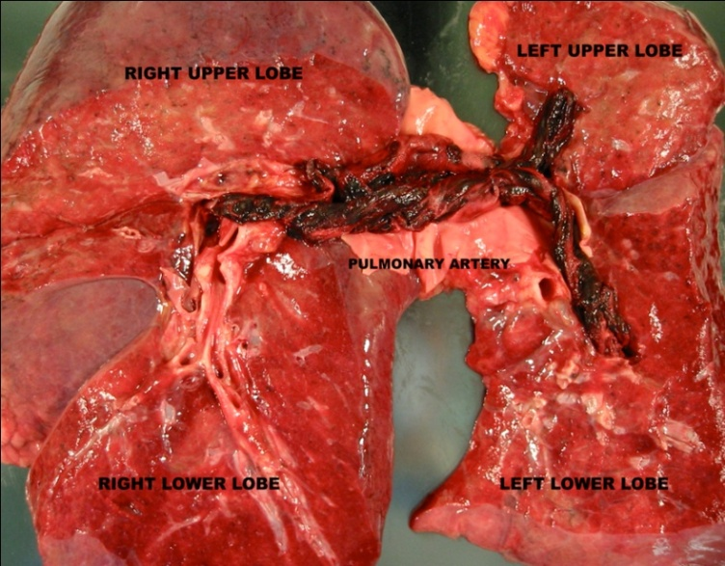
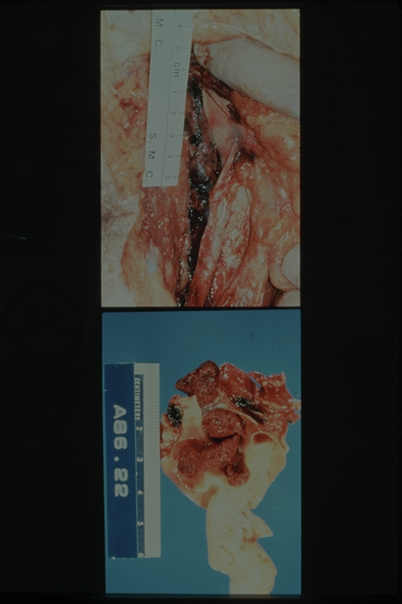
Venous Thromboembolism (VTE) = DVT+PE
Pulmonary
Embolism (PE)
Deep Vein
Thrombosis (DVT)
VTE Toolkit

Slide 18
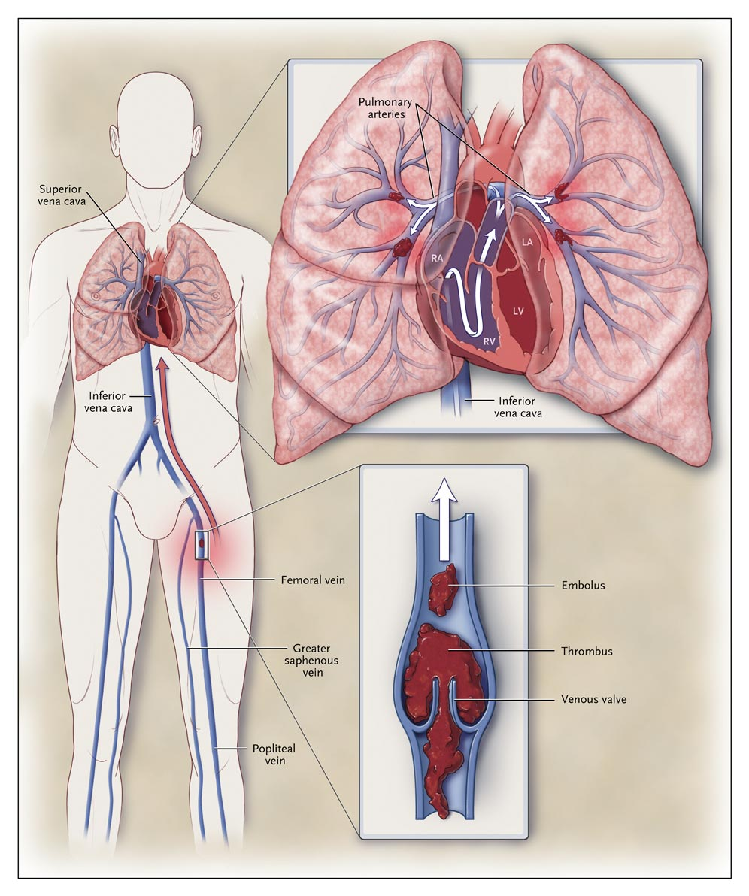
VTE Toolkit

Slide 19
VTE Toolkit

Slide 20
VTE Toolkit

Slide 21
VTE Toolkit

Slide 22
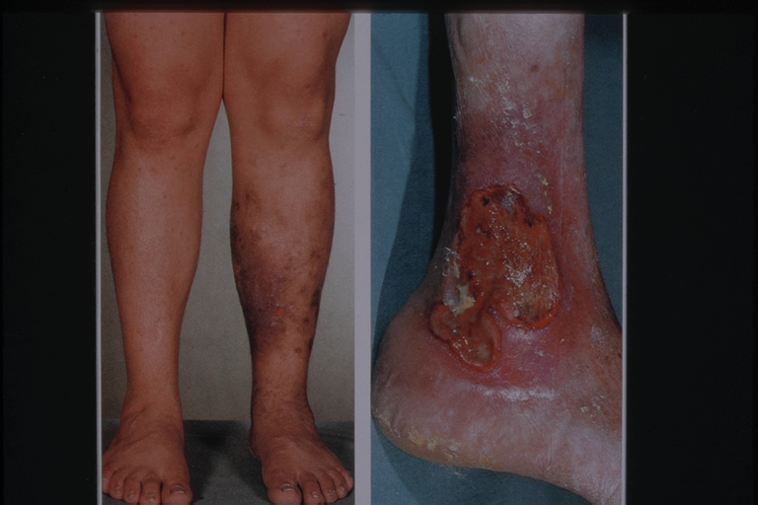
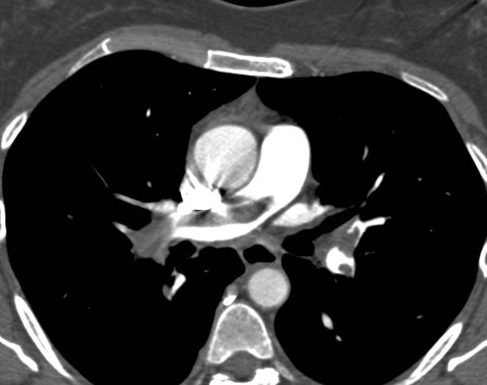

Consequences of DVT and PE
$
VTE Toolkit

Slide 23
Deep Vein Thrombosis (DVT)
Thrombosis in one or more deep veins
* leg is the most common site*
can also be the arm
portal, splenic, mesenteric, cerebral, renal veins
  Proximal DVT - Popliteal, femoral or iliac veins
    - >90% of pulmonary emboli derive from proximal DVT
  Distal or calf DVT - Below the popliteal vein
  - Posterior tibial, peroneal veins
  - Lead to <5% of PE
VTE Toolkit

Slide 24
Pulmonary Embolism (PE)
Thrombus embolizes from a deep vein (usually a proximal leg vein) to the pulmonary arteries
    Massive PE - Hemodynamic compromise
    (~5% of cases) - Shock, cardiac arrest
    Submassive PE - Right heart dysfunction
    (~30% of cases) - Normal BP
    Nonmassive PE - No right heart dysfunction
    (~65% of cases)
VTE Toolkit

Slide 25
Natural History of VTE
  Most DVTs in calf veins undergo spontaneous lysis
  <10% of untreated calf DVTs extend into the proximal veins
  50% of untreated proximal DVTs extend
  50-70% of untreated proximal DVTs cause PE
  Untreated PE 10-30% fatal
VTE Toolkit

Slide 26
Venous Disease Coalition
www.vasculardisease.org/venousdiseasecoalition/
VTE Toolkit

