Slide 1


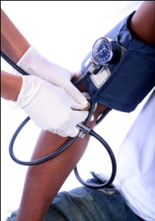




Chapter Four
Venous Disease Coalition
Clinical Presentations of VTE
VTE Toolkit

Slide 2
Symptoms of VTE
  Leg swelling
  Leg pain
  Arm swelling or pain
  SVC syndrome
VTE Toolkit

Slide 3
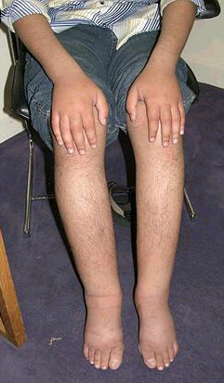
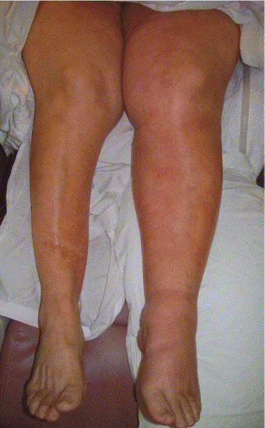
VTE Toolkit

Slide 4
Symptoms of PE
  Sudden shortness of breath
  Gradual shortness of breath
  Pleuritic chest pain
  Hemoptysis
  Unexplained fever
  Presyncope
  Hypotension/shock
  Cardiac arrest/death
VTE Toolkit

Slide 5
Venous Disease Coalition
www.vasculardisease.org/venousdiseasecoalition/
VTE Toolkit

