Slide 1


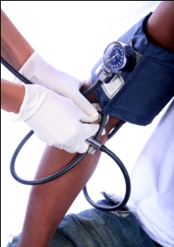




Chapter Five
Venous Disease Coalition
Investigation of Suspected VTE
VTE Toolkit

Slide 2
Investigation of Suspected DVT
Ascending contrast venography
Impedance plethysmography
Radioactive fibrinogen scan
No longer used
Doppler ultrasonography (Duplex scan): sensitive and specific for symptomatic proximal DVT
CT venography: contrast timing critical
MR venography: may be useful for pelvic vein thrombosis
VTE Toolkit

Slide 3
Investigation of Suspected DVT
  Try to never miss acute PROXIMAL DVT
  Some Doppler labs over-call DVT (especially calf DVT)
  No one knows if / how calf DVT should be managed
  Be aware of CLINICAL-IMAGING DISCORDANCE (the clinical features don’t fit with the imaging results)
VTE Toolkit

Slide 4
Clinical Predictive Model for DVT
Active cancer < 6 mos 1
Paralysis, paresis, recent plaster cast 1
Bedridden > 3 d or major surgery < 1 mo 1
Localized tenderness along deep vein 1
Entire leg swollen 1
Calf swelling 3 cm > asymptomatic side 1
Pitting edema symptomatic leg 1
Collateral superficial veins 1
Alternative diagnosis > likely -2
Low = < 0 Mod = 1-2 High = > 3
Wells - Lancet 1997;350:1795
VTE Toolkit

Slide 5
D-dimer in Suspected VTE
  D-dimers are degradation products resulting from the action of plasmin on fibrin
  The presence of D-dimer indicates initiation of blood clotting but many conditions other than DVT give a positive D-Dimer test result
  Therefore, a positive D-dimer does NOT rule in DVT, but a negative D-dimer can help exclude the diagnosis
  D-dimer may be useful in outpatients with low pre-test probability for VTE as part of a formal algorithm
VTE Toolkit

Slide 6
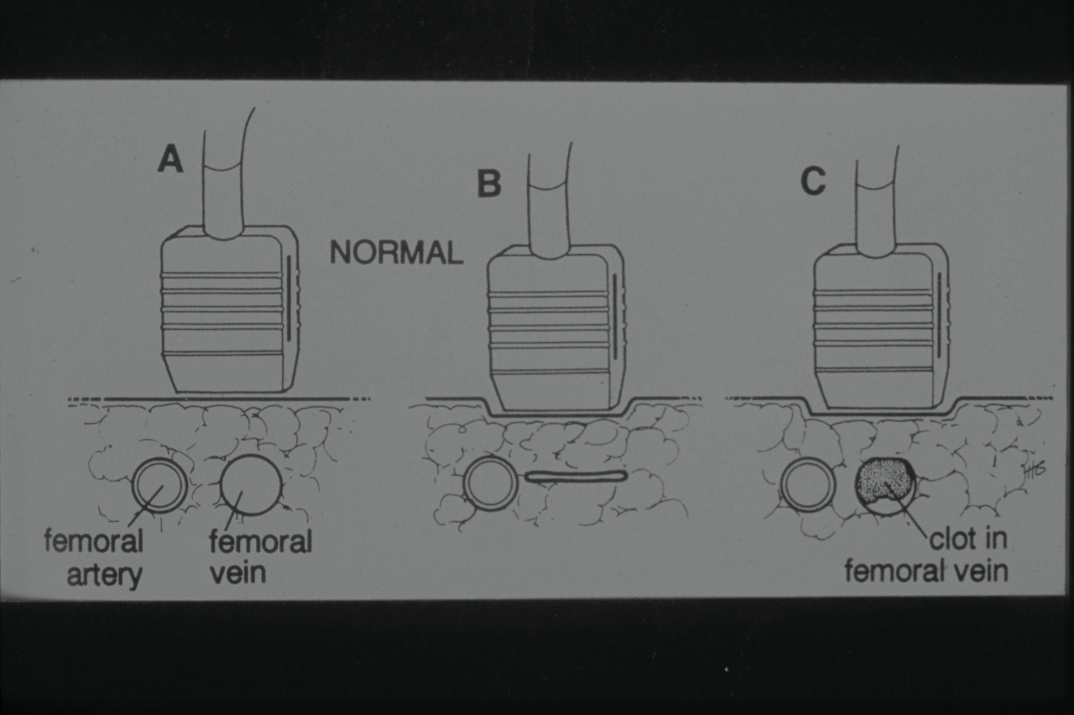
Compression Doppler Ultrasound
VTE Toolkit

Slide 7
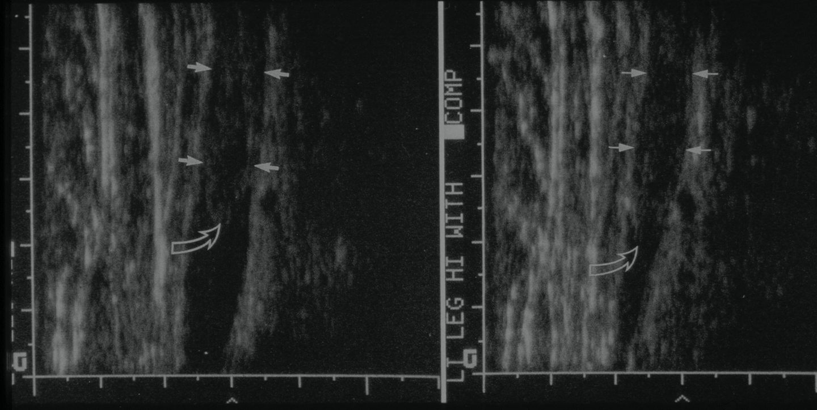
Compression Doppler Ultrasound
Without Compression With Compression
VTE Toolkit

Slide 8
Suspected DVT
Doppler
Ultrasound (DUS)
DUS demonstrates
DVT
DUS negative
Low clinical prob
or alternative
Dx reasonable
DVT suspicion
remains
Treat
Stop
Repeat DUS
in 5-7 days
VTE Toolkit

Slide 9
Suspected DVT in an Outpatient
Clinical probability assessment
Low
Moderate-High
D-dimer
Proximal DUS
Negative
Positive
Positive
Negative
DVT
excluded
Treat
stop
repeat DUS 5-7 d
use D-dimer
VTE Toolkit

Slide 10
Suspected DVT in an Inpatient
Proximal Doppler
ultrasound
Proximal DUS
negative
DUS demonstrates
proximal DVT
Continue DVT
prophylaxis
Treat
VTE Toolkit

Slide 11

CT Can Diagnose Proximal DVT
VTE Toolkit

Slide 12
Investigation of Suspected PE
  No diagnostic value of blood gases in suspected PE
  V/Q scans:
    At least 60% are non-diagnostic
    Consider in some patients with renal dysfunction or severe contrast allergy
    Reasonable option for outpatients with normal CXR, and either very high probability of PE or low probability
    Role in pregnancy and young women (because of reduced radiation dose)
  CT Pulmonary Angiogram (“Spiral CT”):
    Accurate for segmental or larger PE
    Accuracy and clinical relevance of sub-segmental abnormalities is uncertain
VTE Toolkit

Slide 13
Wells Clinical Predictive Model for PE
History
Previous proven DVT or PE 1.5
Immobilization > 3 d or surgery prev. month 1.5
Malignancy (current or < 6 mos.) 1
Hemoptysis 1
Physical exam
Signs of possible DVT (leg swelling, tenderness 3
HR > 100 1.5
Alternative diagnosis
PE as likely or more likely than alternative 3
Pre-test probability score VTE
High >6.0 41-50%
Moderate 2.0-6.0 16-19%
Low <2.0 1-2%
Wells -
Thromb Haemost (2000)
Ann Intern Med (2001)
VTE Toolkit

Slide 14
Revised Geneva Score for
PE Assessment
based on 8 clinical variables (not on clinical judgment)
Points
Age > 65 1
Surgery/fracture past month 2
Active cancer 2
Hemoptysis 2
Previous DVT/PE 3
Unilateral leg pain 3
HR 75-94 3
HR > 95 5
Unilat. edema + tenderness 4
PE
Risk Points prevalence
Low 0-3 8 %
Intermediate 4-10 29 %
High > 11 74 %
Le Gal – Ann Intern Med 2006;144:165
VTE Toolkit

Slide 15
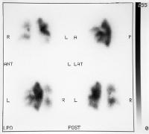
Highly Abnormal Perfusion Scan
VTE Toolkit

Slide 16
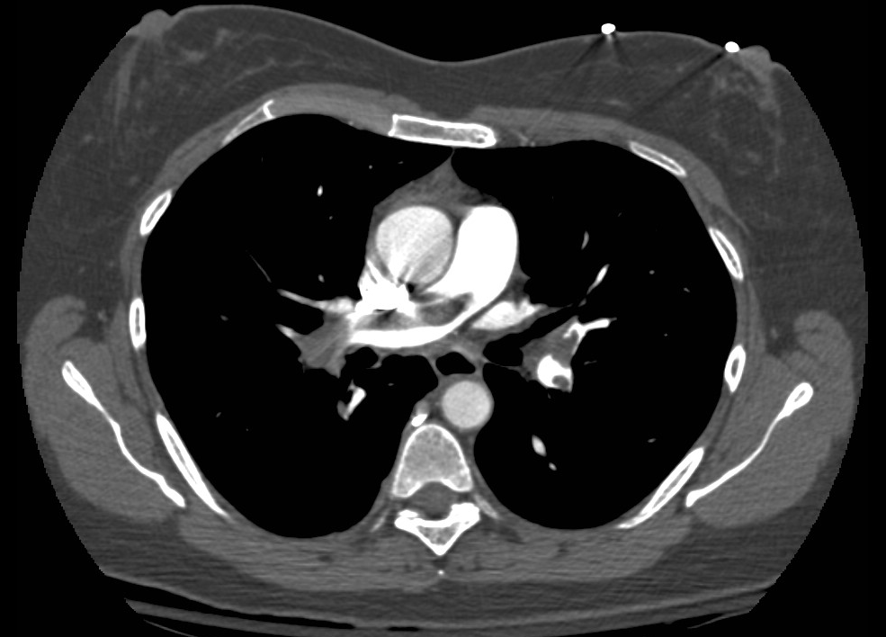
CT Pulmonary Angiogram
VTE Toolkit

Slide 17
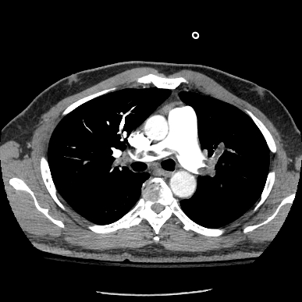
VTE Toolkit

Slide 18
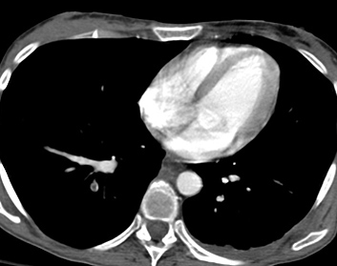
VTE Toolkit

Slide 19
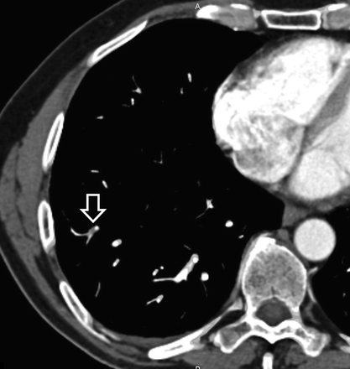
Subsegmental “Something”
Is it PE? Is it important?
VTE Toolkit

Slide 20
Suspected PE in an Outpatient
Clinical probability assessment
Low
?
Moderate
High
D-dimer
CTPA
Negative
Positive
CTPA: no PE
CTPA: nondiag
CTPA: definite PE*
PE excluded
PE
excluded
DUS of
prox veins
repeat CTPA
Treat
*At least segmental filling defect and “reasonable” clinical suspicion
VTE Toolkit

Slide 21
Suspected PE in an Inpatient
CTPA
Definite* PE
No definite PE
Treat
Continue
prophylaxis
*At least segmental filling defect and “reasonable” clinical suspicion
VTE Toolkit

Slide 22
Venous Disease Coalition
www.vasculardisease.org/venousdiseasecoalition/
VTE Toolkit

