Slide 1
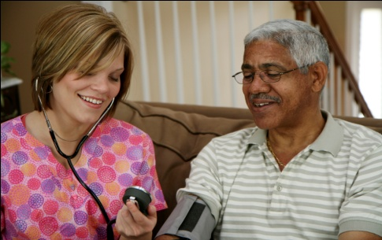
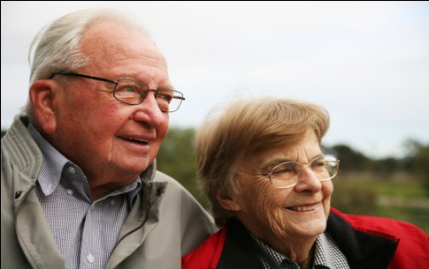
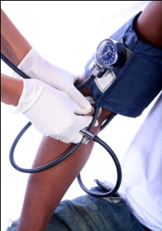




Chapter Six
Venous Disease Coalition
Acute Management of VTE
VTE Toolkit

Slide 2
Objectives of VTE Treatment
  Prevention of PE
  Prevention of DVT extension
  Prevention of recurrent VTE
  Prevention of post-thrombotic syndrome
VTE Toolkit

Slide 3
Principles of Acute VTE Treatment
  Early, rapid therapeutic anticoagulation
    - IV heparin; weight-adjusted SC heparin
    - Weight-adjusted SC LMWH
    - SC fondaparinux
    - Not warfarin alone
  Encourage early ambulation
VTE Toolkit

Slide 4
Low Molecular Weight Heparin
(dalteparin or Fragmin®; enoxaparin or Lovenox®)
  Advantages:
    more predictable response than heparin
    no dosage adjustment
    no need for lab monitoring
    at least as effective as IV heparin
    safer than heparin
    many patients can be treated as outpatients
    cheaper than using heparin
  Disadvantages:
    subcutaneous injection daily
    accumulation in renal dysfunction
VTE Toolkit

Slide 5
Initial Treatment of VTE
  LMWH SC rather than heparin IV for most
    dalteparin (Fragmin®) 200 U/kg SC once daily
    enoxaparin (Lovenox®) 1 mg/kg SC BID
  Use pre-filled syringes (and round up to that dose)
  NO maximum (dose not capped for weight)
  Most patients with DVT and many with PE can be managed entirely as outpatients (if out-patient LMWH can be arranged)
  Most patients can do their own injections
VTE Toolkit

Slide 6
Prophylactic and Treatment doses of LMWHs are NOT the same
(for a 75 kg patient with normal renal function)
LMWH | Prophylaxis dose | Treatment dose
dalteparin (Fragmin®) | 5,000 U QD | 15,000 U QD (200 U/kg QD*)
enoxaparin (Lovenox®) | 30 mg bid or 40 mg QD | 80 mg BID (1.0 mg/kg BID*)
*no maximum
VTE Toolkit

Slide 7
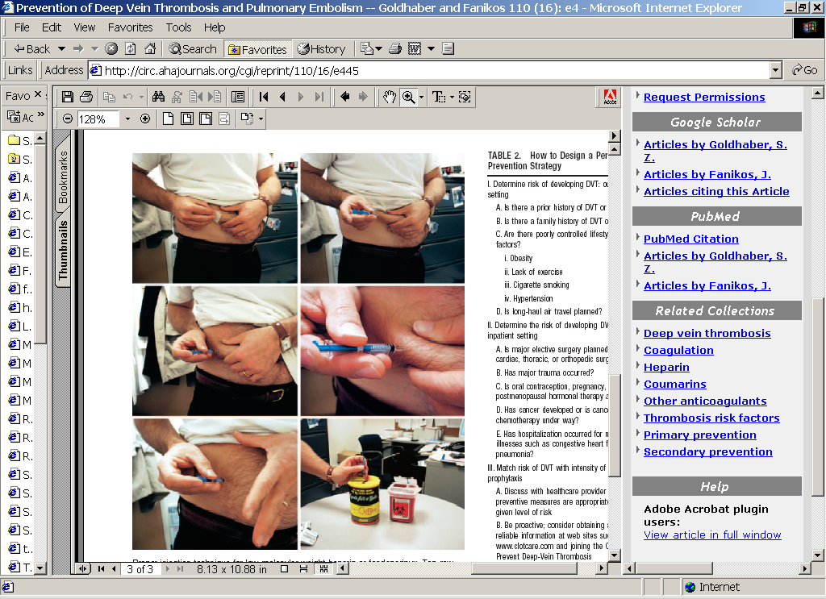
Injection of LMWH
Patients can do their own injections with minimal instruction
VTE Toolkit

Slide 8
Use of Unfractionated Heparin
Therapy for DVT or PE
  Dose varies markedly among patients
  APTT target = 2.0 – 3.0 times control
  Aim to obtain target APTT ASAP
    Failure to achieve therapeutic APTT within 24 hours is associated with 23% recurrence of VTE compared to 5% in those therapeutic within 24 hours!!
VTE Toolkit

Slide 9
Initial IV Heparin Therapy for DVT or PE
  Indications (rare)
    Massive PE, during lytic therapy
    severe renal dysfunction
    unstable patient
    failed LMWH
  Bolus: 5,000 units
  Starting infusion: 20 units/kg/hr
  Target aPTT: 2 - 3 times control (~70-90 sec)
  Use a nomogram
VTE Toolkit

Slide 10
Heparin-Induced
Thrombocytopenia (HIT)
  Occurs in 1-5% of patients given therapeutic heparin for more than 5 days (less common with LMWH)
  HIT leads to venous and/or arterial thrombosis in approximately 50% of patients as well as amputations and deaths
  Is the most hypercoagulable state known
VTE Toolkit

Slide 11
Management of Heparin-Induced
Thrombocytopenia (HIT)
  Stop heparin (and LMWH) in all forms
  Start a HIT-safe alternative anticoagulant
    Argatroban
    Bivalirudin
    Lepirudin
    Fondaparinux
  3. Confirm the diagnosis
VTE Toolkit

Slide 12
Initial Treatment of VTE
  Start warfarin on the same day as LMWH or heparin (if warfarin is an appropriate option)
  Continue LMWH at least 5 days and until INR >2.0 for 2 days
  Early mobilization is very important
VTE Toolkit

Slide 13
Admission Criteria for Acute VTE
DVT: (few need to be admitted*)
  Very high bleeding risk
  Severe renal dysfunction
  Patients with extensive iliofemoral DVT who are considered for catheter thrombolysis
PE: (many can be treated as outpatients*)
  Hemodynamically unstable
  Requires O₂ or parenteral narcotics
  Very high bleeding risk
  Severe renal dysfunction
  Massive PE requiring catheter thrombolysis
*if outpatient low molecular weight heparin can be arranged
VTE Toolkit

Slide 14
Acute PE
~5%
~5%
~30%
~60%
Cardiac arrest
Clinical
massive PE
Submassive PE
All the rest
extensive PE
hypotension
overt RHF
extensive PE
no hypotension
or overt RHF
RVD on echo
↑ Tp, BNP
Mortality:
70-95% 20-50% 5-10% < 3%
BNP = brain natruiretic peptide; RHF = right heart failure; RVD = right ventricular dysfunction;
Tp = troponin
VTE Toolkit

Slide 15
Acute PE
Is patient hemodynamically stable?
YES
No
RV dysfunction
?
Anticoagulate
Anticoagulate
+ Embolus reduction
procedure
- catheter thrombolysis
- IV thrombolysis
- embolectomy
VTE Toolkit

Slide 16
Treatment Options for Massive PE
Surgical embolectomy
  Available in very few centers & when needed
  High mortality and morbidity
IV thrombolysis
  Contraindicated in 70% of patients
  Often small benefit
  Definite increased bleeding risk
Catheter-directed thrombus reduction
  Few contraindications
  Appears to be highly effective but no RCTs
  Appears to be safe
VTE Toolkit

Slide 17
Meta-Analysis of Randomized Trails of IV Thrombolytic Therapy for PE
11 RCTs, 748 patients
Outcome Heparin Lysis Odds Ratio
Recurrent PE, death 9.6 % 6.7 % 0.7 [0.4-1.1]
Death 5.9 % 4.3 % 0.7 [0.4-1.3]
Bleeding - major 6.1 % 9.1 % 1.4 [0.8-2.5]
- nonmajor 10.0 % 22.7 % 2.6 [1.5-4.5]
~
~
~
<
Wan – Circulation 2004;110:744
VTE Toolkit

Slide 18
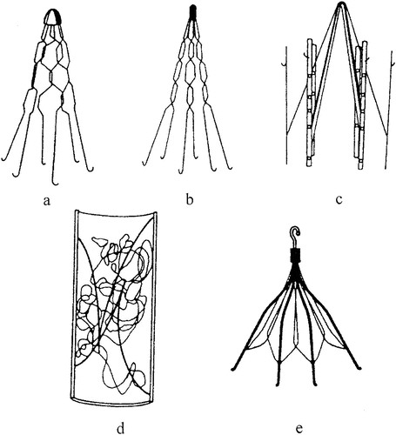
Accepted Indication for an IVC Filter
Recent PROXIMAL DVT or PE
PLUS an absolute contra-indication to full anticoagulation
Uncertain (controversial) indications:
        Big DVT + poor cardiopul. reserve
        “Recurrent” VTE/failure of Rx
        Primary prophylaxis
VTE Toolkit

Slide 19
Retrievable IVC Filter
    Up to 80% are NOT removed!
    No data about long-term implications
    Require 2 central venous procedures
    ↑ cost
    ↑ radiology time
    ↑ risks
    ↑ radiation
VTE Toolkit

Slide 20
8th ACCP Conference on
Antithrombotic Therapy
  IVC Filter Use:
    Recommend AGAINST IVCF in addition to anticoagulation [Grade 1A]
    Recommended if acute proximal DVT with contraindication to anticoagulation [Grade 1A]
    When high bleeding risk resolves, use conventional anticoagulation as for patients without a filter [Grade 1C]
Kearon – Chest 2008
VTE Toolkit

Slide 21
Venous Disease Coalition
www.vasculardisease.org/venousdiseasecoalition/
VTE Toolkit

