Slide 1

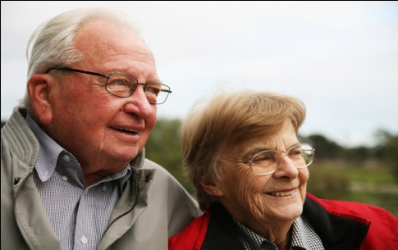
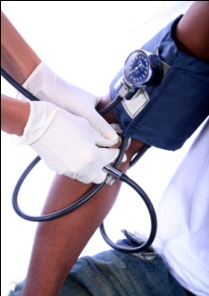




Chapter Eight
Venous Disease Coalition
Safe Use of Oral Anticoagulants
VTE Toolkit

Slide 2
Action of Vitamin K Antagonists
(Warafin)
    Inhibit the production of functional vitamin K dependent clotting factors II, VII, IX, X
    Also inhibit the anti-clotting factors Protein C & S
    Initial changes in INR reflect inhibition of Factor VII (shortest half-life); other factors take nearly a week to decrease to thrombosis-preventing levels
    20-fold or greater range in maintenance dose among groups of patients (<1 mg/day to >20 mg/day)
    Contraindicated in pregnancy
VTE Toolkit

Slide 3
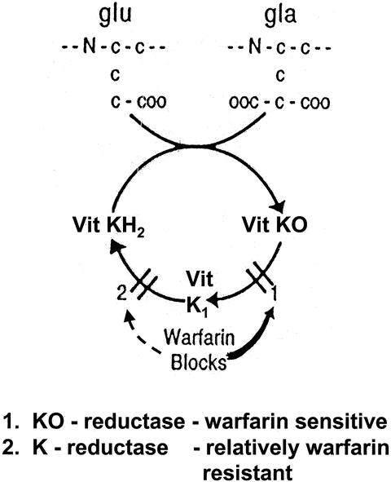
Mechanism of Action of Warafin
Hypofunctional clotting factors (II, VII, IX, X)
Functional clotting factors
(II, VII, IX, X)
Food
GIB
GIB = gastrointestinal bacteria
VTE Toolkit

Slide 4
Vitamin K Dependent Clotting Factors
XII
XI
Tissue factor
IX
VIII
VII
X
aPTT
V
PT/INR
II (Thrombin)
I (Fibrinogen)
Fibrin clot
VTE Toolkit

Slide 5
Factors Contributing to Patient Variability in Warafin Dose
Age
Weight
Race
Liver disease
Heart failure
Genetics:
  - cytochrome P450 2C9 polymorphisms (CYP 2C9)
  - vitamin K epoxide reductase (VKOR) polymorphisms
Alcohol intake
Nutritional status
Diet
Activity level
Drug interactions
Patient compliance
Who’s supervising anticoagulation
VTE Toolkit

Slide 6
Factors Increasing Bleeding Risk on Oral Anticoagulants
    Age > 75
    Also receiving antiplatelet drugs
    Uncontrolled hypertension
    History of bleeding (GI, intracranial)
    Cancer
    Chronic renal failure
    Poorly controlled / poorly supervised anticoagulant therapy
VTE Toolkit

Slide 7
Long-Term Treatment of VTE with a Vitamin K Antagonist (Warafin)
    Target INR = 2.0 - 3.0
    Lower INR (1.5-1.9) is associated with increased VTE recurrence, but NOT decreased risk of bleeding
VTE Toolkit

Slide 8
Warafin Therapy - Principles
    Patient and physician must be obsessive
    Do not order daily INR – use long-term trends
    Use a warfarin dosing sheet (for both MD and patient) = a longitudinal record of doses, INR results, next INR date
    Don’t over-react to just out-of-range INR values
    Stop ASA/clopidogrel unless indicated
    Manage hypertension aggressively
    Encourage vitamin K intake
VTE Toolkit

Slide 9
Diet and Warafin Use
    Do NOT advise restriction of vitamin K-containing food – this is associated with less stable INR values
    Encourage foods high in vitamin K (broccoli, spinach, brussel sprouts)
    “Let me know if you plan a major change in your usual diet”
VTE Toolkit

Slide 10
Warafin and Alcohol
    Binge drinking → increases INR
    → may reduce compliance
    → increases UGI bleed risk
    → reduces the stability of
    anticoagulation
    Recommend moderation NOT abstinence
VTE Toolkit

Slide 11
New Drugs and Warafin
    Assume new drugs might affect the INR
    For a known interaction (or uncertain):
      - get INR 4-5 days after starting
    If INR was increased previously with the same antibiotic, reduce warfarin dose for a few days
VTE Toolkit

Slide 12
ASA and Warafin Use
    Generally AVOID
    No additional benefit for most patients
    Definite increase in bleeding risk
    There must be a good reason for the ASA, e.g. coronary artery stent, high-risk mechanical heart valve, acute coronary syndrome, TIA/stroke on warfarin
    Therefore, the combination of an antiplatelet agent and warfarin must be an ACTIVE decision
VTE Toolkit

Slide 13
NSAIDs and Warafin Use
    Not anticoagulants; minimal platelet inhibition
    Effect on INR unpredictable (may ↑ it)
    Like all meds, there should be a good reason for the NSAID
    If starting regular NSAID use, check INR 4-5 days later (if using PRN, don’t bother)
    If high-risk of GI bleeding → avoid or add PPI (age >60, previous PUD, GERD, steroids)
VTE Toolkit

Slide 14
What to do if INR is not what was expected
    If the INR value is not what you
    expected, ask the question,
        “Why did this happen?”
VTE Toolkit

Slide 15
INR Higher than Expected
    Miscommunication about dosing by the doctor or patient
    “Tell me what doses you’ve taken since the last INR”
    New medication – antibiotics, high dose acetaminophen, amiodarone, NSAIDs, statins, omeprazole, over-the counter drugs, herbals
    Substantial alcohol excess
    Inter-current illness
    Nutrition change – decrease vitamin K intake
VTE Toolkit

Slide 16
INR Lower than Expected
    Compliance
    Compliance
    Compliance
    Miscommunication about dosing by the doctor or patient
    “Tell me what doses you’ve taken since the last INR”
    Nutrition change – increase vitamin K intake
    New medication – ginseng, green tea
VTE Toolkit

Slide 17
Reducing Warafin-Related
Bleeding in Practice
    Things you CANNOT change
      age
      comorbid conditions
    2. Things you CAN influence
      careful management of hypertension
      avoid combined ASA, other antiplatelets if possible
      excellent patient education
      obsessive supervision and tracking
      appropriate management of elevated INR
VTE Toolkit

Slide 18
Venous Disease Coalition
www.vasculardisease.org/venousdiseasecoalition/
VTE Toolkit

